Slide 1
Cluster

Slide 2
DBSCAN
DBSCAN is a clustering method that is used in machine learning to separate clusters of high density from clusters of low density. Given that DBSCAN is a density based clustering algorithm, it does a great job of seeking areas in the data that have a high density of observations, versus areas of the data that are not very dense with observations. DBSCAN can sort data into clusters of varying shapes as well, another strong advantage. DBSCAN works as such:

Slide 3
DBSCAN
Divides the dataset into n dimensions
For each point in the dataset, DBSCAN forms an n dimensional shape around that data point, and then counts how many data points fall within that shape.
DBSCAN counts this shape as a cluster. DBSCAN iteratively expands the cluster, by going through each individual point within the cluster, and counting the number of other data points nearby. Take the graphic below for an example:

Slide 4
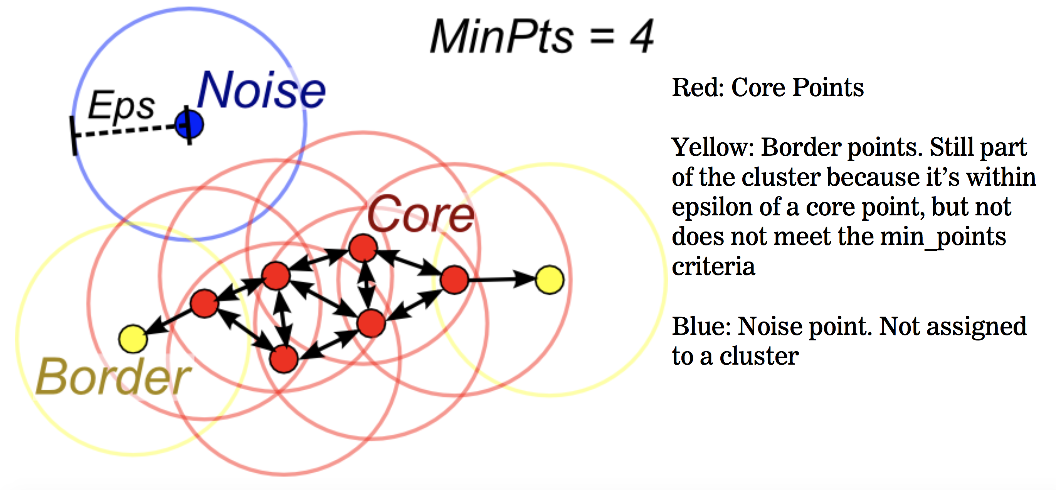
DBSCAN
d

Slide 5
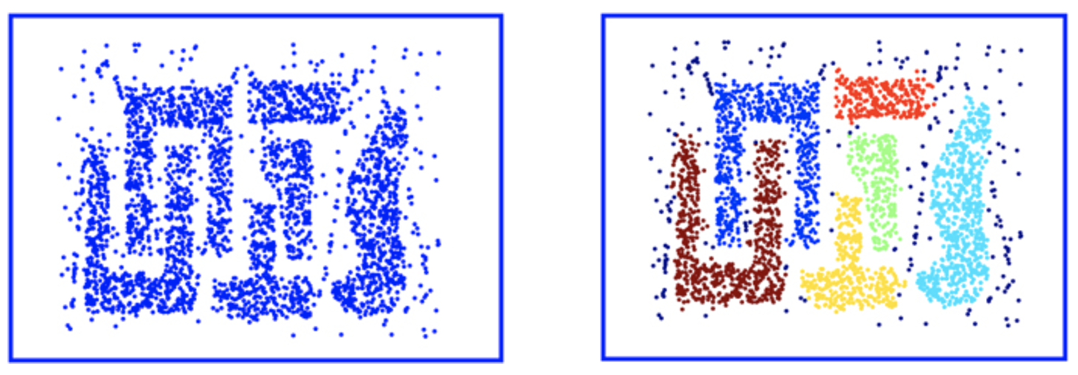
DBSCAN - Example

Slide 6
DBSCAN - Summary
A cluster then satisfies two properties:
All points within the cluster are mutually density-connected.
If a point is density-reachable from any point of the cluster, it is part of the cluster as well.

Slide 7
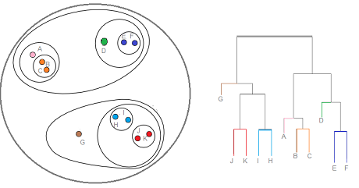
Hierarchical Clustering
Hierarchical Clustering - בנית קבוצות של דוגמאות וארגונם בעצים, ע"פ יחסי ההיררכיה בניהם
כל קצה בגרף העצים מייצג חלק מהקבוצה
הבניה של הקבוצות נעשית ע"פ המרחקים בין הדוגמאות

Slide 8
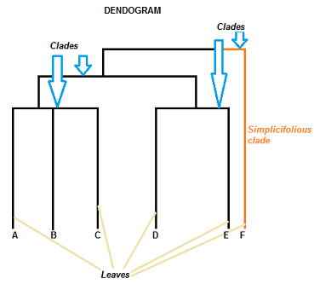
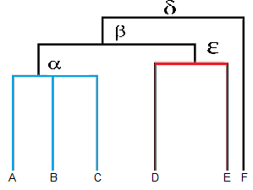
Hierarchical Clustering - Dendrogram
s

Slide 9
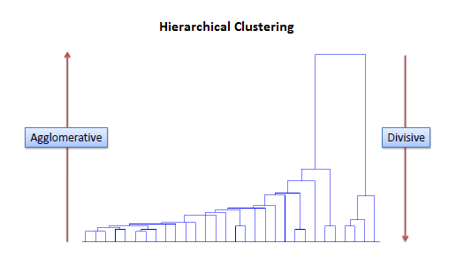
Hierarchical Clustering

Slide 10
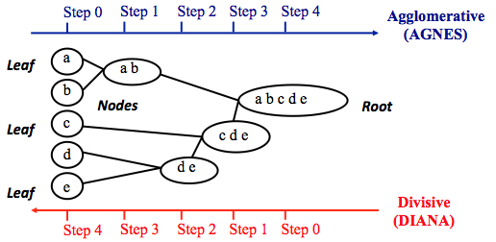
Hierarchical Clustering

Slide 11
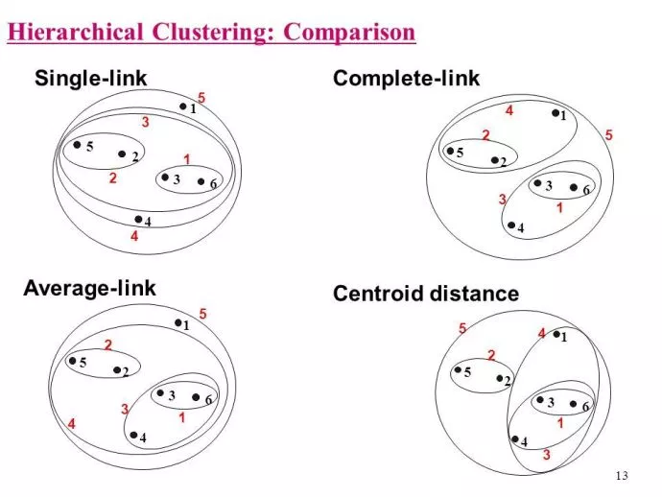
Hierarchical Clustering

Slide 12
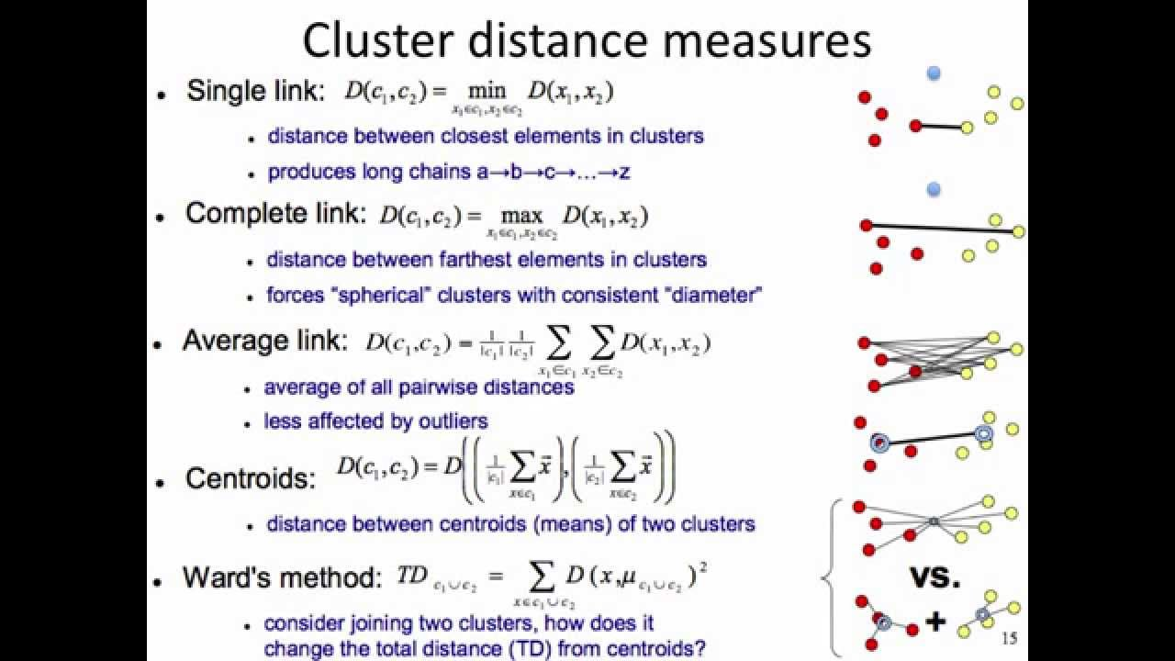
Hierarchical Clustering
הסבר - איך עובדת החלוקה מבחינת מרחק

